Slide 1

Machine learning algorithms
to predict price of cryptocurrency

Slide 2
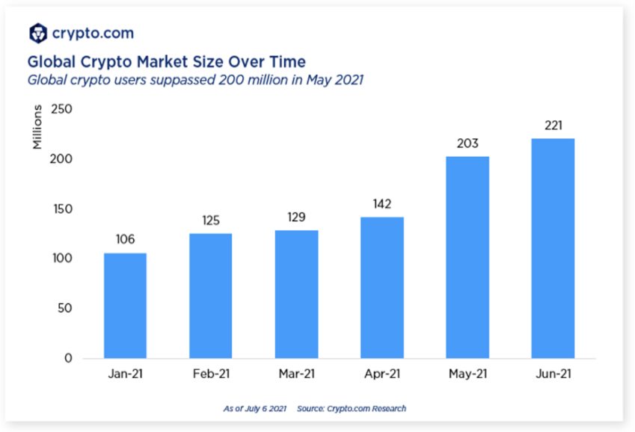

Part 2,
Why We choose this Project?

Slide 3

Part 2,
Why We choose this Project?
Cryptocurrency is currently experiencing rapid price fluctuations.
There are many speculative factors -> dangerous to invest without accurate information.
Analyzing price algorithms helps to identify the causes of bitcoin price fluctuations and predict future price fluctuations.
This enables stable investment and increases the stability of investors.

Slide 4
Case 1

Slide 5


Purpose of the study
“Prediction Performance of Altcoin Price using Machine Learning Algorithm”
To find machine learning with high prediction accuracy even in situations of high price volatility in the altcoin market.
Classification
To evaluate the prediction performance of machine learning algorithms in the altcoin market and provide methods and directions for price prediction.
Compare
Factors Analysis

Slide 6
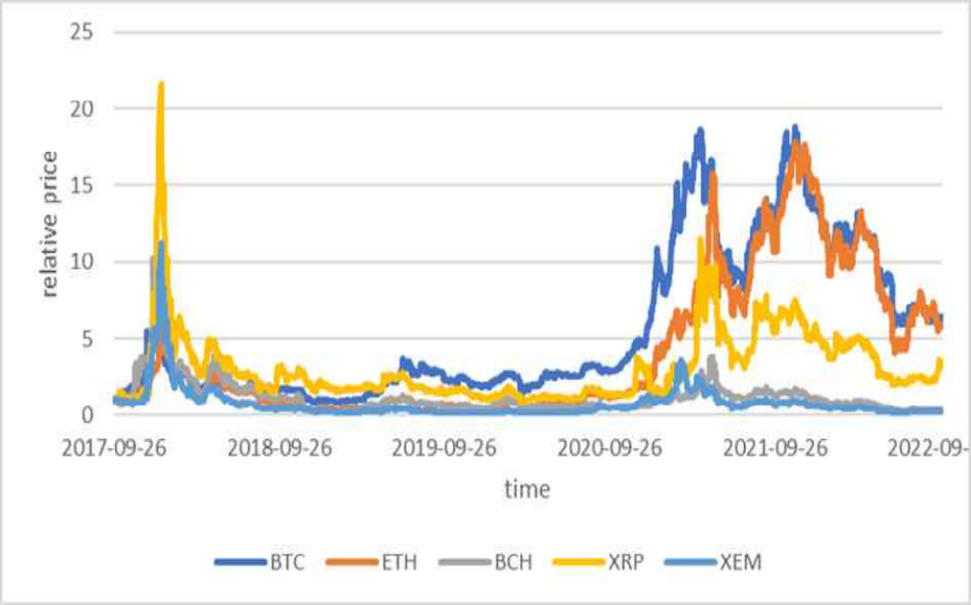
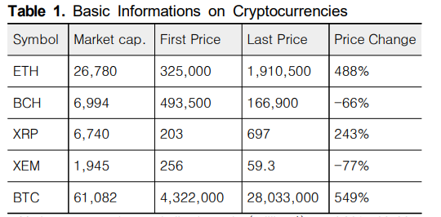
2. Dataset
Classification
Ethereum, Bitcoin Cash, Ripple, Xem, Bitcoin
<The data collection period>
26, 09, 2017 ~ 30, 09, 2022.
Daily open, high, low, and close prices
Compare
Factors Analysis

Slide 7
3. Data analysis
Predictive models
Random Forest: A technique for generating multiple decision trees and synthesizing the predictions of each decision tree model to determine the most class as the final prediction value
XGB: Improved algorithm of boosting technology in decision trees
Support Vector Regression: Similar to conventional artificial neural networks
but suitable for predicting time series data, such as moving stock prices
LSTM: Predictive model for time series data.
Learning the relationship between the input data at the previous and current point in time
to predict the output value at the next point in time
너 있다보자
Classification
Compare
Factors Analysis

Slide 8
3. Data analysis
Predictive models
Random Forest: A technique for generating multiple decision trees and synthesizing the predictions of each decision tree model to determine the most class as the final prediction value
XGB: Improved algorithm of boosting technology in decision trees
Support Vector Regression: Similar to conventional artificial neural networks
but suitable for predicting time series data, such as moving stock prices
LSTM: Predictive model for time series data.
Learning the relationship between the input data at the previous and current point in time
to predict the output value at the next point in time
너 있다보자
Classification
Compare
Factors Analysis

Slide 9
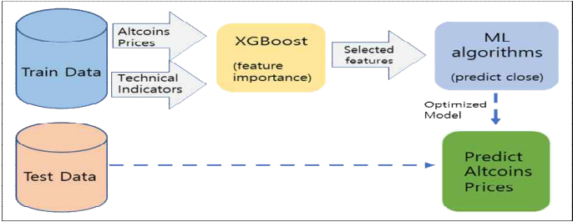
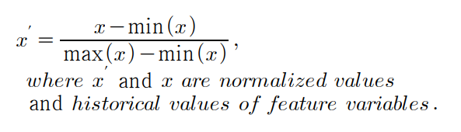
3. Data analysis
Classification
Normalization
Step 1) Select a High-Importance Attribute Variable through XGB’s F-Score
(15 Input Variables including market price, high & low price)
Step 2) Using 4 machine learning algorithms with variables selected in step 1 as inputs.
Compare
Factors Analysis

Slide 10

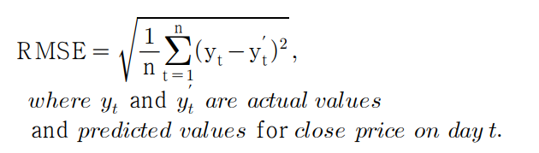
3. Data analysis
Step 3) Apply the optimized algorithm to the verification data
to predict the daily closing price of Altcoin the next day.
Classification
Step 4) Comparison of predictive performance of algorithms by comparing predictive and actual values
Compare
Factors Analysis

Slide 11
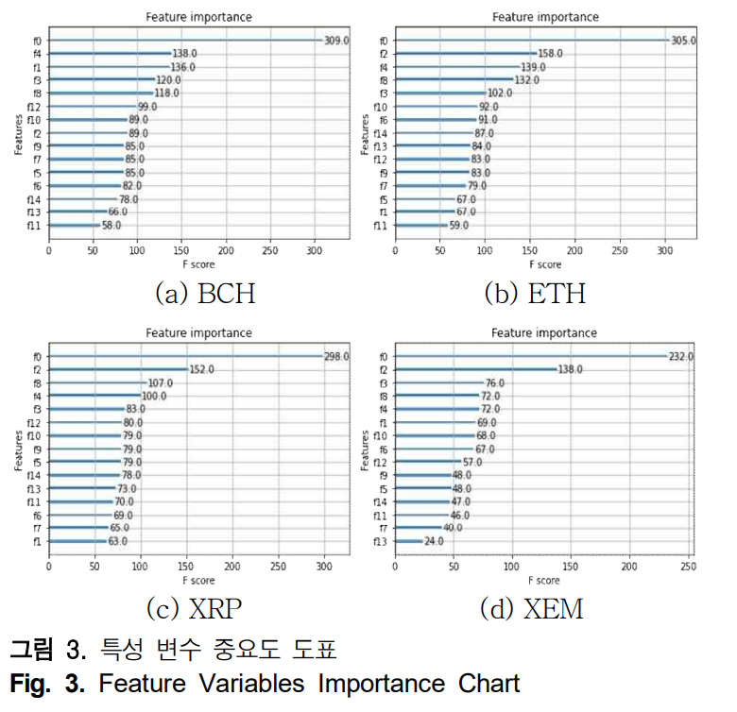
4. Results
What is important feature to predict price? "High price" is showing the highest F-score in price prediction among all altcoins, followed by “low price”.
technical indicators: CCI, RSI, and MACD are showing high importance.
CCI (Commodity Channel Index)
RSI (Relative Strength Index)
MACD (Moving Average Convergence Divergence)
Classification
Compare
Factors Analysis

Slide 12
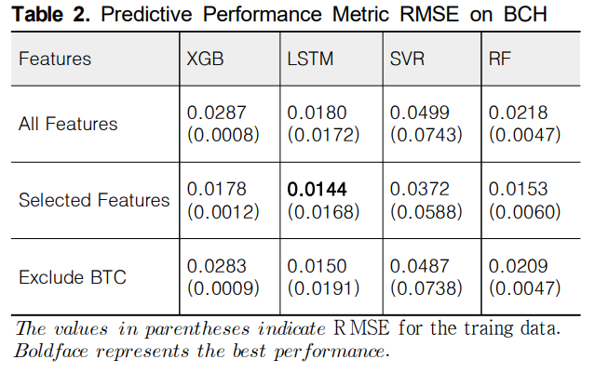
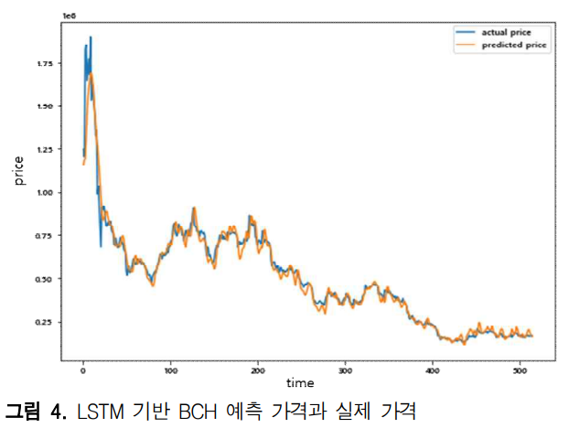
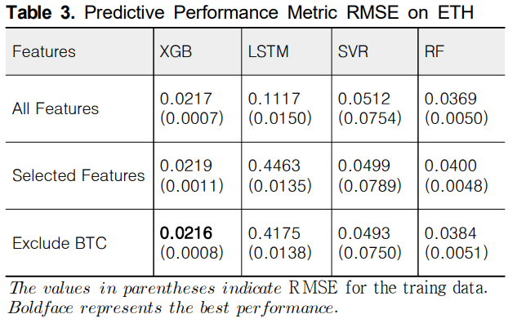
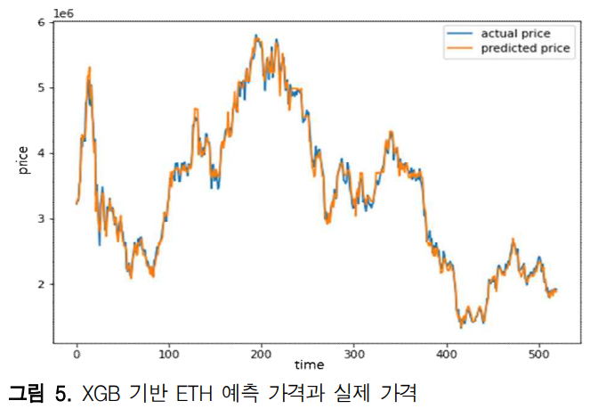
4. Results
Bitcoin Cash
“LSTM”
Classification
Etherium
“XGB”
Compare
Factors Analysis

Slide 13
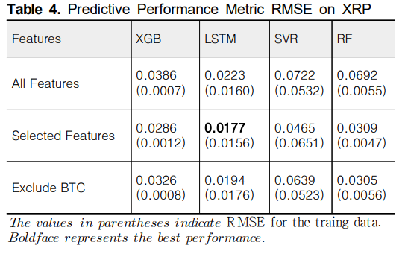
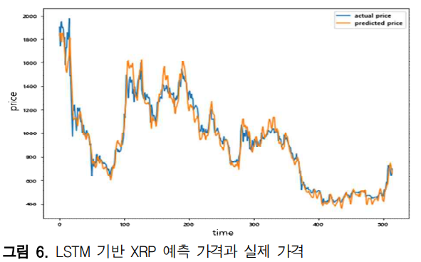
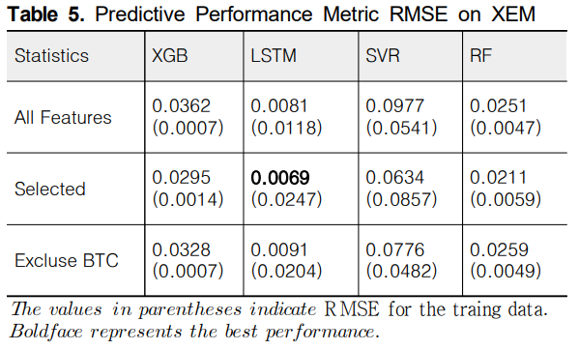
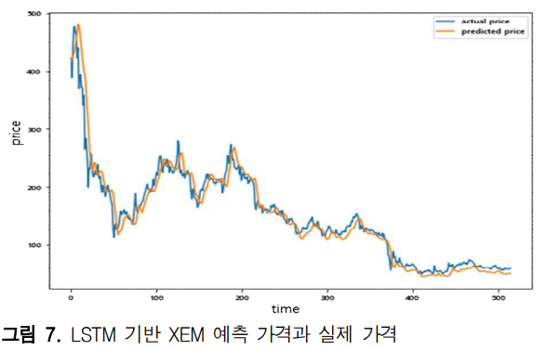
4. Results
Ripple
“LSTM”
Classification
Xem
“LSTM”
Compare
Factors Analysis

Slide 14
4. Results
Conclusion
1) As a result of identifying the relative importance of 15 characteristic variables using XGBoost algorithm, the high importance was the daily highest price.
2) Influence of Bitcoin on the price of altcoins was weak.
3) Accuracy of predicting altcoin prices was the highest in LSTM except for Ethereum.
-> revealing the usefulness of the LSTM model in the prediction of time series data.

Slide 15
5. Limitations
Limitations
1) Cryptocurrency prices have weakness in accurate price prediction due to the characteristics of fluctuating according to various external factors.
2) Failed to provide an explanation on why Ethereum's prediction results differ from
those of Bitcoin Cash, Ripple, and Xem, which have relatively small market capitalization.
Classification
Compare
Factors Analysis

Slide 16
Case Study 2

Slide 17
Part 2,
Why We choose this Project?

Slide 18
Part 2,
Why We choose this Project?
Cryptocurrency is currently experiencing rapid price fluctuations.
There are many speculative factors -> dangerous to invest without accurate information.
Analyzing price algorithms helps to identify the causes of bitcoin price fluctuations and predict future price fluctuations.
This enables stable investment and increases the stability of investors.

Slide 19

Q.
Importance and necessity
in terms of target industry or technique

Slide 20

Part 2,
Importance and necessity in terms of target industry or technique
Using machine learning techniques for cryptocurrency price prediction is significant in the field of
finance and investment.
Machine learning techniques have shown promising results by analyzing various factors such as historical price data, trading volumes, market sentiment, news sentiment, and social media trends.
These techniques can help investors and traders make data-driven decisions and manage their investments more effectively.
Classification
Compare
Factors Analysis

Slide 21

Part 2,
Data mining
Classification
Compare
Factors Analysis
XGB, LSTM, SVM, Random Forest

Slide 22

Part 2,
Importance and necessity in terms of target industry or technique
Using machine learning techniques for cryptocurrency price prediction is also significant in the field of
artificial intelligence and data science.
It provides an excellent opportunity to apply and test various machine learning algorithms and models, thereby improving their accuracy and efficiency in predicting financial markets' trends.
Classification
Compare
Factors Analysis

Slide 23
Case Study

Slide 24

Purpose of the Study
Strong volatility in prices, as cryptocurrencies are largely based on public perception
Difficult to perform a related risk assessment at any time with rising prices
Compare

Slide 25

Purpose of the Study
For determining the right prediction with good accuracy, the proposed study performed deep analysis on dataset to understand the market behavior by using several machine learning algorithms
Which machine learning algorithms performs best?
Compare

Slide 26




Datasets
Compare
Top 4 cryptocurrencies

Slide 27
Columns
Slug | Symbol | Name | Date | Rank now | Open | High | Low | Close | Volume | Market | Closeratio | Spread
… | … | … | … | … | … | … | … | … | … | … | … | …
Slug: another name of a particular currency
Symbol: an identifier symbol
Ranknow: the current rank of cryptocurrency
Open: starting price of a particular date
High: the highest price of a particular date
Close: the value at end of the day
Volume: the quantity of transaction in a day
Market: the total value of the market in a day
Close_ratio: the daily close rate, min-maxed with the high and low values for the day
close_ratio = (close-low)/(high-low)
Spread: the difference between the high and low value in day

Slide 28
Additional Columns
To find significant differences in the experimental result,
Hlc_average: the average of high, low, and close values of a day
hlc_average=(high+low+close)/3
Ohlc_average: the average of the open, high, low, and close values of a day
ohlc_average=(open+high+low+close)/4

Slide 29
Data Analysis Methods
Machine learning algorithms
Linear Regression
Random Forest Regressor
Gradient Boosting Regressor
XGBoost
For every algorithms,
R-square, Mean Absolute Error, and Mean Squared Error caculated for checking the performance and accuracy of the trained model
Checks which one of the algorithms is giving the best result

Slide 30

Data Analysis Methods
Linear Regression
Linear approach for modelling the relationship between a scalar response and one or more explanatory variables
https://en.wikipedia.org/wiki/Linear_regression

Slide 31
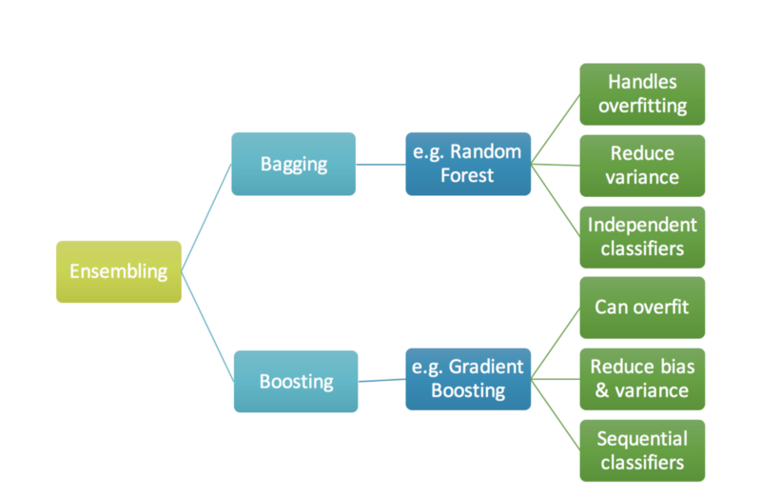
Data Analysis Methods
Gradient Boosting Regressor
Machine learning technique used in regression and classification tasks
One of the most popular machine learning algorithms for tabular(table) datasets
Gives a prediction model in the form of an ensemble of weak prediction models, which are typically decision trees
When a decision tree is the weak learner, the resulting algorithm is called gradient-boosted trees
Usually outperforms random forest
https://en.wikipedia.org/wiki/Gradient_boosting

Slide 32
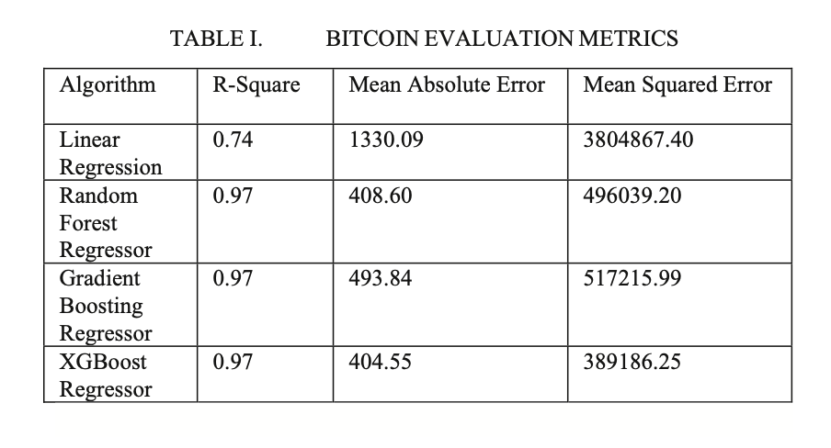
Results
For every algorithms,
R-square, Mean Absolute Error, and Mean Squared Error calculated for each cryptocurrencies to check the performance and accuracy of the trained model
Checks which one of the algorithms is giving the best result
https://en.wikipedia.org/wiki/Linear_regression

Slide 33
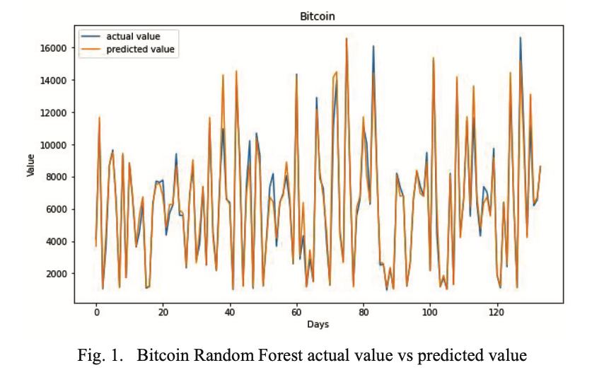
Bitcoin Evaluation Metrics
From Table 1, it is clear that XGBoost Regressor gives best result with 97% accuracy along with high R2 score, low Mean Absolute Error, and low Mean Squared Error.

Slide 34
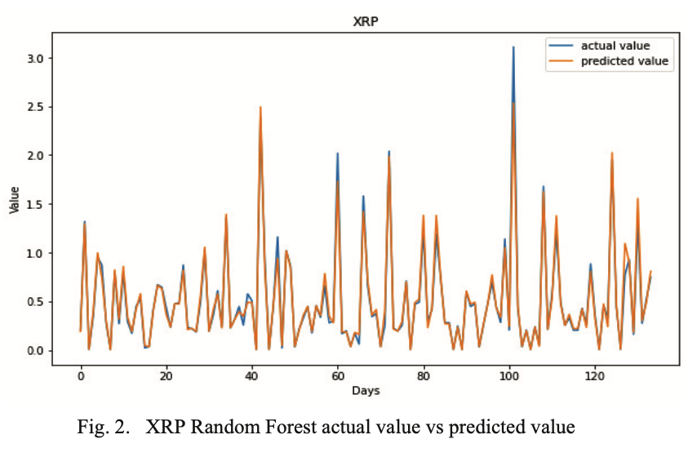
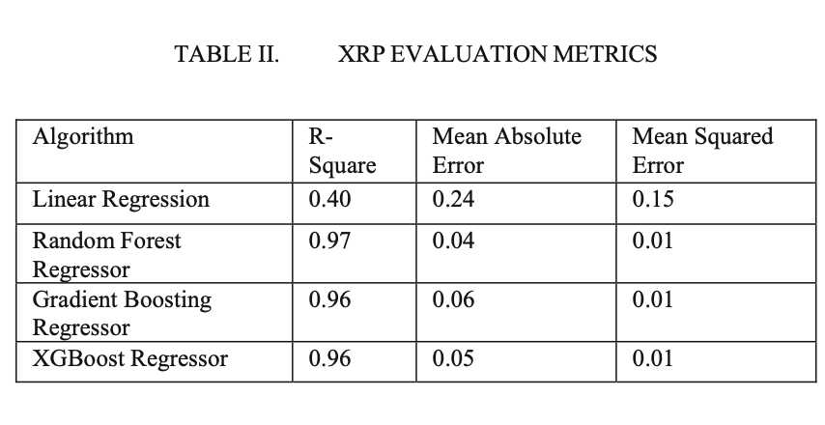
XRP Evaluation Metrics
From Table 2 it is clear that Random Forest Regressor gives the best result with 97% accuracy along with high R2 score, low Mean Absolute Error, and low Mean Squared Error.

Slide 35
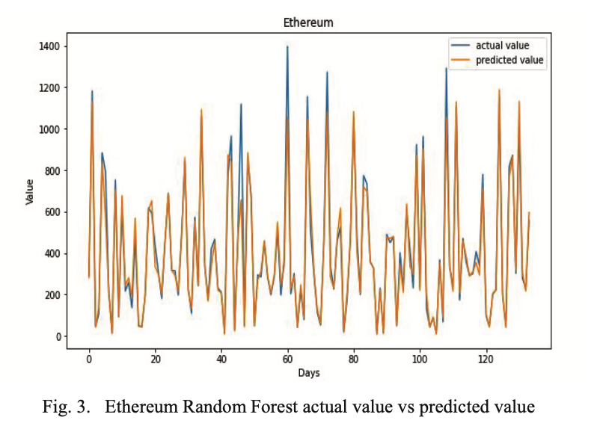
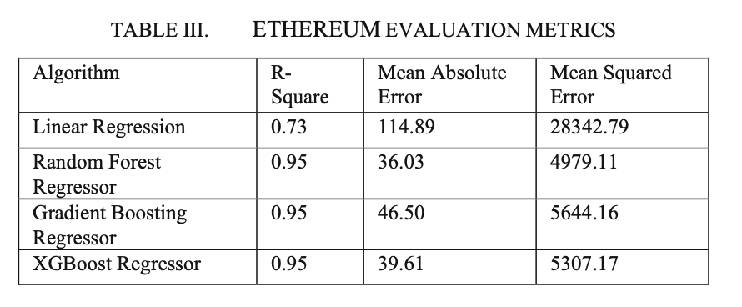
Ethereum Evaluation Metrics
From Table 3 it is clear that Random Forest Regressor gives the best result with 95% accuracy along with high R2 score, low Mean Absolute Error, and low Mean Squared Error.

Slide 36
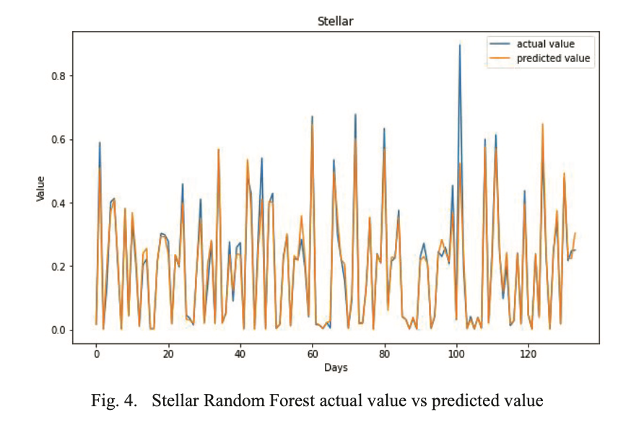
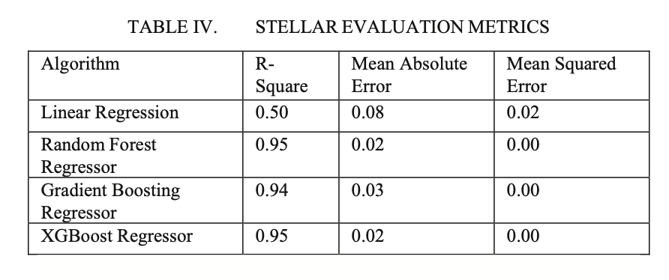
Stellar Evaluation Metrics
From Table 3 it is clear that Random Forest Regressor and XG Boost give the best result with 95% accuracy along with high R2 score, low Mean Absolute Error, and low Mean Squared Error.

Slide 37
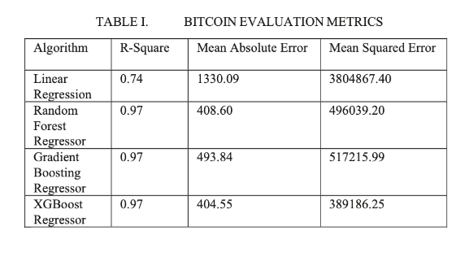
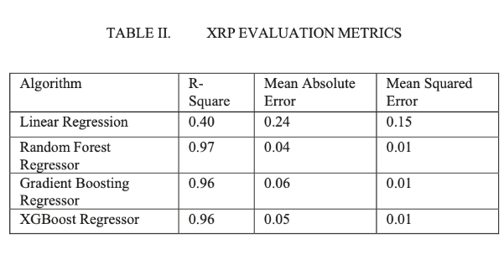

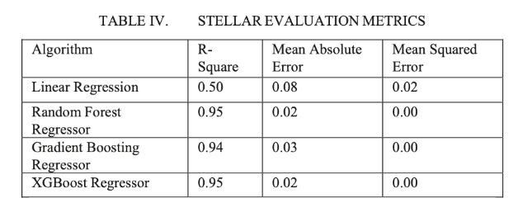
Results
The analysis and results show that Random Forest Regressor is giving the best results in the case of every cryptocurrency.

Slide 38
Case Study 3

Slide 39

Part 1
Purposed Work
virtual currency has no substance and there is no central bank that controls
In this way, if virtual currency does not secure stability and normality, it is judged that virtual currency will not be able to properly function as currency.
Therefore, multivariate analysis is applied to derive a multiple regression equation that reveals the degree of factors influencing cryptocurrency price fluctuations.

Slide 40
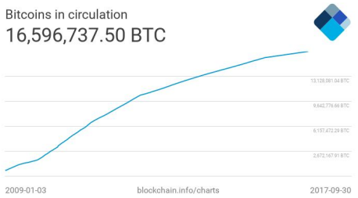
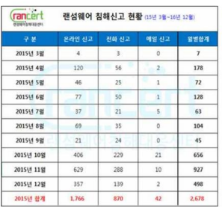
Part 2,
DataSet
In this paper, using multiple regression analysis, one of the multivariate analysis methods,
Confirm the degree of factors affecting the price fluctuation of virtual currency and express it as a multiple regression equation.
Price data is analyzed by limiting the scope to only the top three cryptocurrencies (Bitcoin, Ethereum, Ripple).
Analysis is limited to trading volume, issuance volume, number of ransomware infringement reports, exchange rate (USD/CNY, USD/KRW), and gold futures market price factors.

Slide 41
Part 3,
Data Analysis Methods
1. Simple regression analysis of each explanatory variable and bitcoin price
Trading volume | Multiple R^2: 0.2488, Adjusted R^2: 0.2443
Issuance volume | Multiple R^2: 0.3435, Adjusted R^2: 0.3429
Number of ransomware | Multiple R^2: 0.05272, Adjusted R^2: 0.005355
USD/CNY | Multiple R^2: 0.2715, Adjusted R^2: 0.271
USD/KRW | Multiple R^2: 0.001794, Adjusted R^2: 0.00115
Gold futures | Multiple R^2: 0.1096, Adjusted R^2: 0.109
Classification
Compare
Transaction volume, issuance volume, USD/CNY, and gold futures prices
showed significant results of simple regression analysis with Bitcoin price.

Slide 42
Part 3,
Data Analysis Methods
2. Multiple regression analysis – ex) Bitcoin
F statistics | 147.3
P value | 2.2e - 16
Classification
Compare
Price = -7493 + 0.09724 * transaction volume
+ 0.0002129 * issuing volume
+ 496.6 * USD/CNY
+ 1.456 * gold futures

Slide 43
Part 4,
Analysis Results
1. Whether explanatory variables affect cryptocurrency price fluctuations
Explanatory variables | Bitcoin | Etherium | Ripple
Transaction volume | O | O | O
Issuing volume | O | X | O
Number of Ransomware | X | X | O
USD/CNY | O | O | O
USD/KRW | X | O | O
Gold futures | O | O | O
Classification
Compare
Factors Analysis

Slide 44
Part 4,
Analysis Results
2. The extent to which independent variables affect cryptocurrency price fluctuations
Explanatory variables | Bitcoin | Etherium | Ripple
Transaction volume | 0.009724 | 0.0000001759 | 0.0000000003461
Issuing volume | 0.0002129 | - | -
Number of Ransomware | - | - | -
USD/CNY | 496.6 | - | 0.0548
USD/KRW | - | -0.2223 | -
Gold futures | 1.456 | 0.1024 | 0.00008409
Classification
Compare
Factors Analysis

Slide 45

Part 4,
Final Results - Bitcoin
The independent variable that has the greatest impact on Bitcoin price fluctuations is USD/CNY with a regression coefficient value of 496.6.
Next, the independent variable that had the greatest impact on the price fluctuations of bitcoin was gold futures market price, trading volume, and issuance volume, in order, and demand for safe assets had the second largest influence on bitcoin price fluctuations.
And the supply of Bitcoin, which can be seen as transaction volume and issuance volume, had the third largest impact.
Compare

Slide 46

Part 4,
Final Results - Ethereum
The independent variable that has the greatest impact on Ethereum price fluctuations is USD/KRW, which has the largest absolute value of the regression coefficient -0.223.
This means that fluctuations in the value of the Korean currency had the greatest impact on the price fluctuations of Ethereum.
However, in this case, the regression coefficient shows a negative value, so the situation is opposite to Bitcoin.
In other words, when the Korean won appreciates, the trend of increasing the price of Ethereum is the most conspicuous.
Compare

Slide 47

Part 4,
Final Results - Ripple
Finally, despite the fluctuations in the price of Ripple, the regression coefficient value is the largest at 0.0548.USD/CNY was shown to have the greatest impact.
Next, in order of gold futures market price and trading volume, Ripple also had the second largest influence on safe-haven assets, and the third largest influence on Ripple supply.
However, in the case of Ripple, the market size is smaller than that of Bitcoin and Ethereum.
Therefore, Ripple should exhibit greater price volatility than Bitcoin and Ethereum.
Considering that the regression coefficient values of Ripple are very small, it is assumed that there are other factors other than the explanatory variables selected in this paper that have a greater impact on Ripple's price fluctuations.
Compare

Slide 48

Part 5,
Limitations
Classification
Other factors not included in the analysis can be said to be limitations of this paper.
Independent variables could not be set using the existing method due to missing values in the data set.
Compare
Factors Analysis

